Slide 1

Cloud Computing
Simple Chat Server
Hannah Haist ID:752731
Trang Le Hong ID:310195
Felix Schoch ID:761390

Slide 2

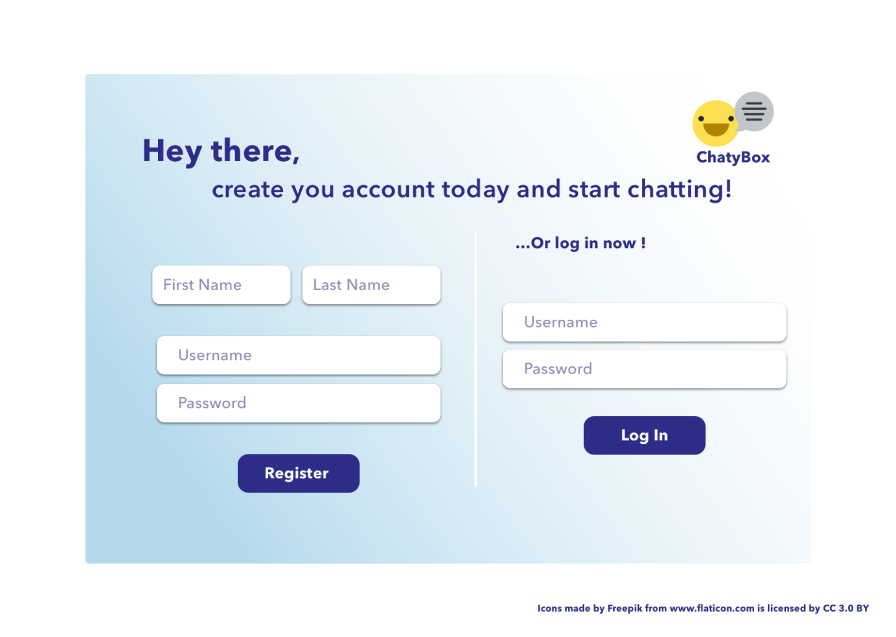
Cloud Computing
Design Mockups

Slide 3
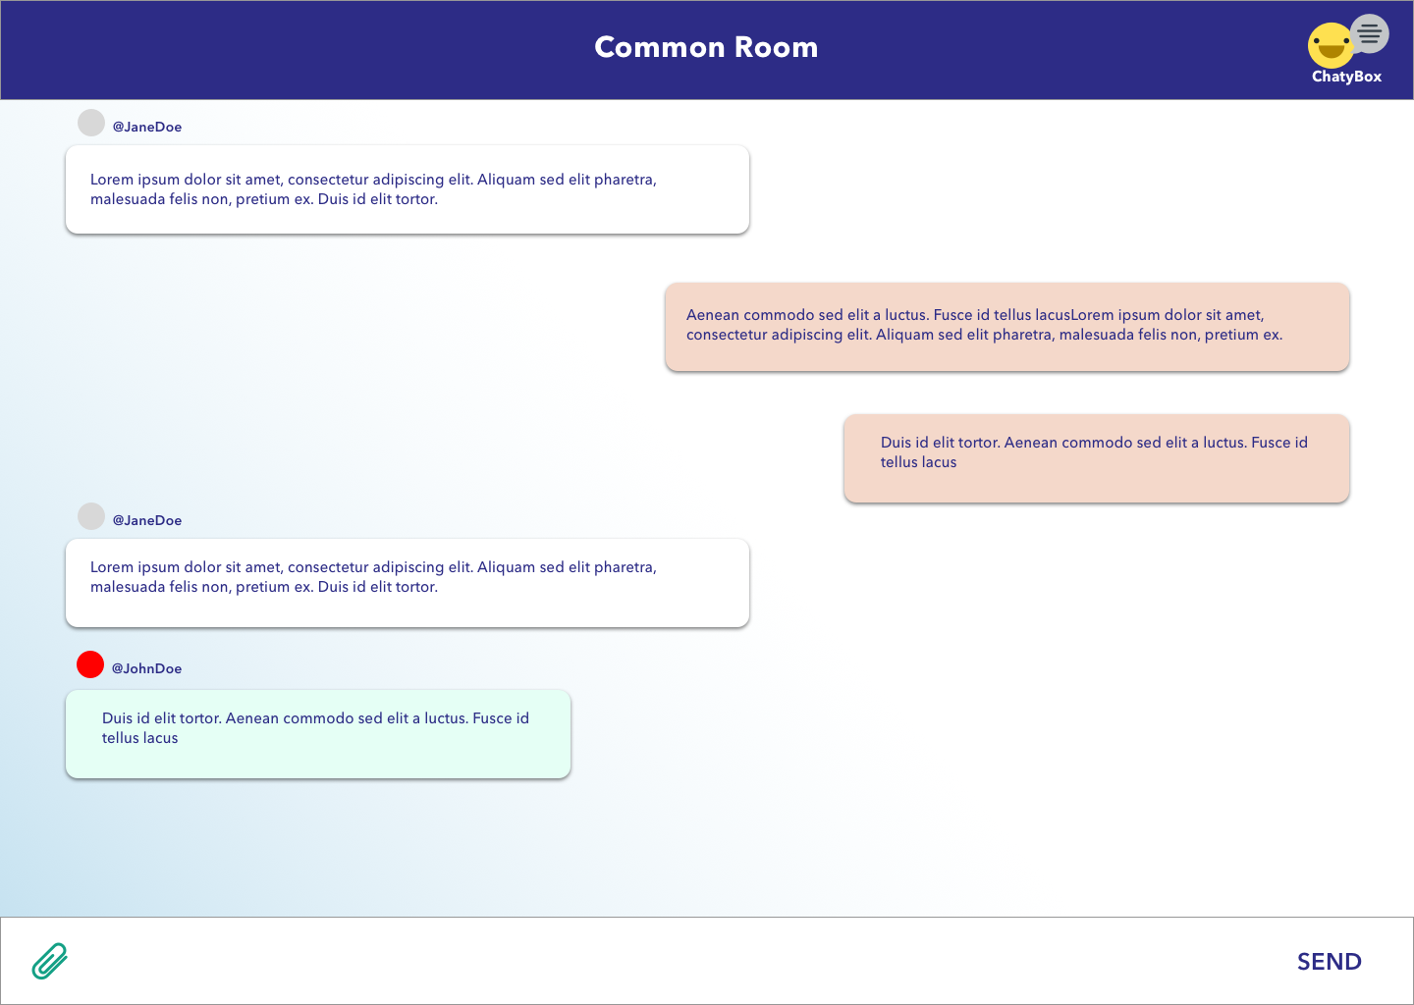
Cloud Computing
Design Mockups

Slide 4
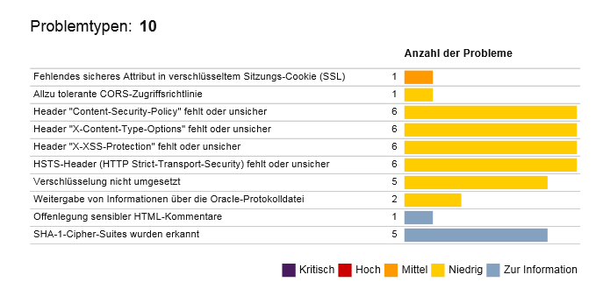
Cloud Computing
Security Report & How we fixed it

Slide 5
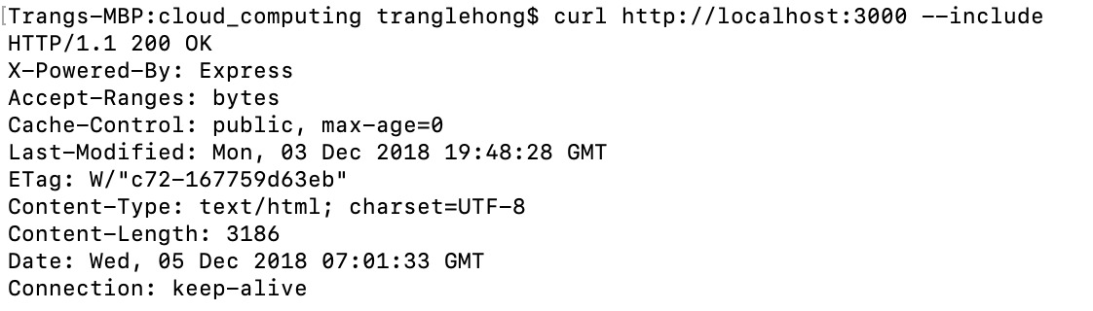
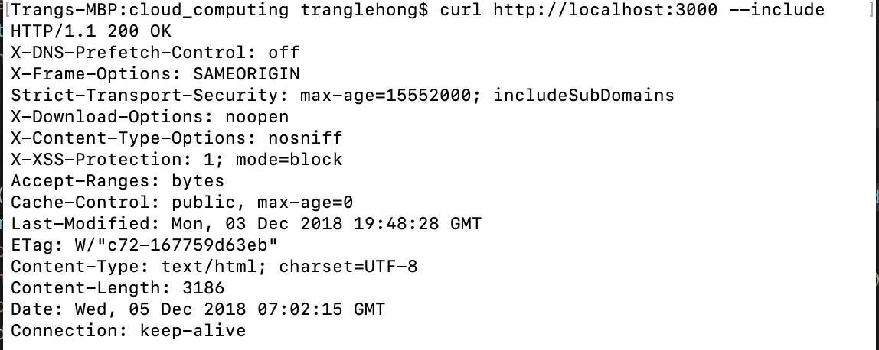
Cloud Computing
Security Report & How we fixed it
App after fixing problems ↓
App before fixing problems ↑

Slide 6

Cloud Computing
Security Report & How we fixed it
Using Helmet module

Slide 7
Cloud Computing
Lessons Learned about node.js
helmet module make it very easy to ensure basic security set up for the server
with IBM standard domain, tls protocol is provided automatically, but the case is different for custom domain

Slide 8

Cloud Computing
Live Presentation

